Slide 1


Part 1 Cloud Spending Efficiency Guide for Apache Spark on Cloud Instances

Slide 2

Cloud Spending Efficiency Guide for Apache Spark on Cloud Instances
Until recently, most companies didn’t care how much they spent on their cloud resources. But in a covid-19 world, companies like Expedia Group™ are reducing cloud spending where reasonable.
While many Apache Spark tuning guides discuss how to get the best performance using Spark, none of them ever discuss the cost of that performance.
Notes:
How I saved 60% of costs in an Apache Spark job, with no increase in job time and no decrease in data processed
This guide will discuss how to get the best performance with Spark at the most efficient cost. It will also discuss how to estimate the cost of your jobs and what makes up actual costs on AWS. In addition, the guide will recommend a cost tuning strategy that is entirely focused on executor configuration so that no code changes are necessary.
If you are an experienced Spark tuner, I will warn you that a paradigm shift is necessary from current tuning practices in order to reduce your Spark job costs on AWS. But I promise these techniques will work.
In this guide, I will share the proven tuning principles that Expedia is using to reduce cloud spending by 30%-80% with our batch Spark jobs that run on AWS. There’s a lot to cover so this guide will be released as a multi-part series. The full series will consist of the following parts.

Slide 3
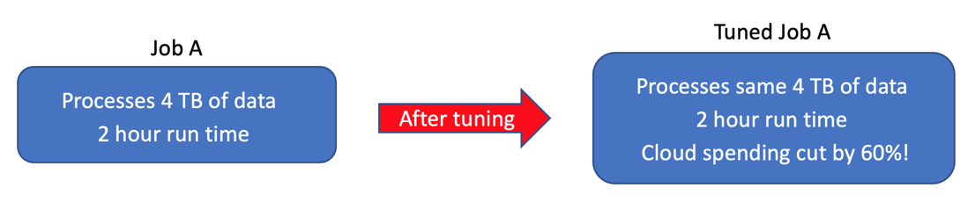
Reducing cloud spending
While Spark is easy to learn, it is also difficult to tune for efficient processing without a good knowledge of Spark internals.
For example, take a job that I tuned which processed 4 TBs of data over two hours. After proper cost tuning, this job processed the same 4 TBs of data in the same amount of time but for a third of the cloud spending cost!

Slide 4
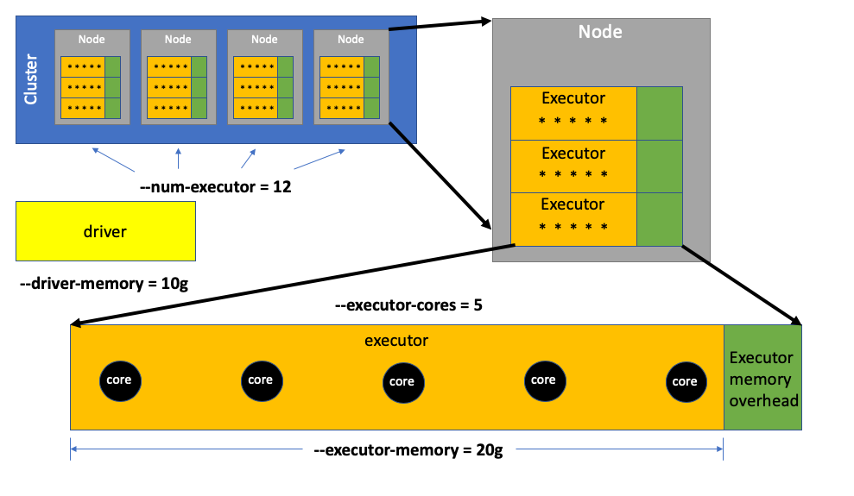
Spark Executor model
Every time a data engineer submits a Spark job, there are four parameters they usually submit that are crucial to determining how well the job performs.
Notes:
In order to understand the key to tuning for cloud spending efficiency, you have to understand the Spark executor model. Here’s a brief overview of the Spark executor model for the non-data engineers reading this blog. Data engineers are welcome to scroll down to the “Key to cloud efficiency” section.
--num-executors determines how many executors are used to process the data.
--executor-cores specifies the number of Spark cores that make up each executor. Spark cores do all the work of processing data in an executor. In the above example, 12 executors with 5 Spark cores each equates to 60 Spark cores processing data.
The Spark cores within an executor use a pool of memory allocated to the executor by the data engineer using --executor-memory.
And then a driver coordinates the processing of data for all the executors using a memory pool allocated to the driver by the data engineer using --driver-memory.

Slide 5
Spark Executor model
When a new executor won’t fit in the node’s available memory, a new node will be spun up (depending on your auto-scaling policy) and added to the cluster to host that new executor.
Each node has a fixed number of CPUs available for processing data by Spark cores.
While executors can’t exceed the node’s available physical memory, they can have more Spark cores than available CPUs on that node.
Notes:
Executors are allocated to individual EC2 instances (aka nodes) on a cluster until the physical memory on that node is consumed.

Slide 6
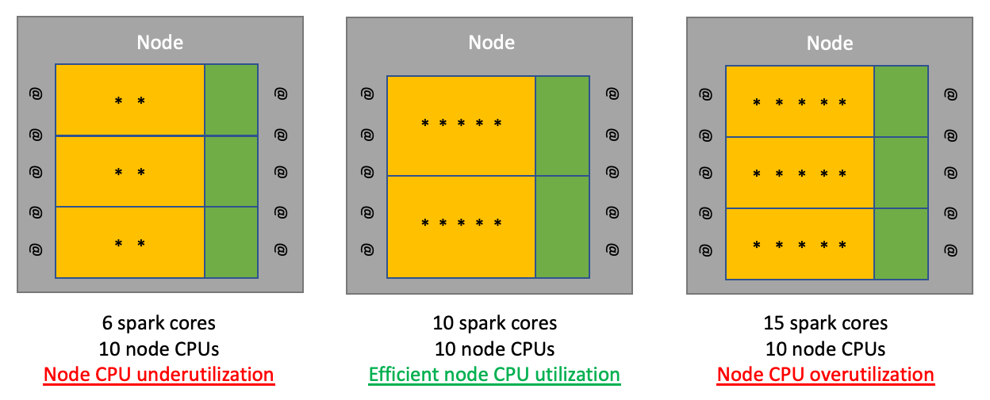
Key to cloud efficiency
Notes:
When the Spark cores of all executors on a node exceeds the available CPUs on that node, time-slicing occurs as each Spark core waits its turn to be processed by the overworked CPUs. Time-slicing is inefficient node utilization and should be avoided. Conversely, if the Spark cores of all executors on a node is lower than the available CPUs, then the node CPUs will be underutilized which is also inefficient node utilization. When your Spark core count for all executors on a node matches the number of available node CPUs, then you have efficient CPU utilization of that node.

Slide 7
Key to cloud efficiency
The goal for minimizing cloud spending when running Spark jobs is simple.
You want to make sure your executors are configured so that Spark is efficiently utilizing all available node CPUs without time-slicing.
The reason why is because AWS/GCP charges you on a per node per second basis for every Spark job that runs on a cluster.
If a job runs on fewer nodes but completes in the same amount of time, then you save money for that job.

Slide 8
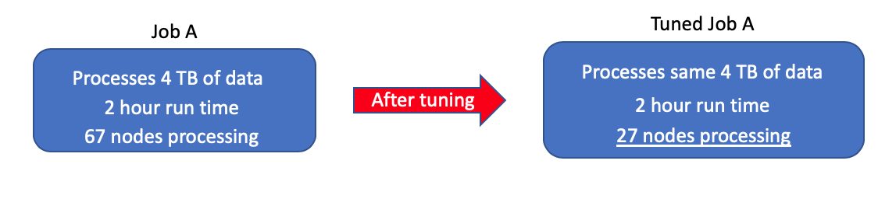
Key to cloud efficiency
The tuned job had the same number of Spark cores as the untuned job, but that equal number of Spark cores were squeezed into fewer nodes.
Notes:
The non-tuned job I mentioned earlier used only a third of the available CPUs on each node because of an inefficient executor configuration. As a result, the non-tuned job used three times as many nodes to process the same data as the tuned job. After the job was cost tuned the node count dropped by almost two thirds because the efficiently configured executors used every available CPU on each node.

Slide 9
60% fewer nodes running with same run time = 60% reduction in cloud spending
The challenge with squeezing the right number of Spark cores onto a node is that it’s how you configure your executor memory that determines how many Spark cores ultimately reside on your node.
And in some cases, maximizing Spark cores on a node can actually make your job run slower (but still cheaper).

